Slide 1
Interactive Study Planner
KV4006_DanielQue_w24014217

Slide 2
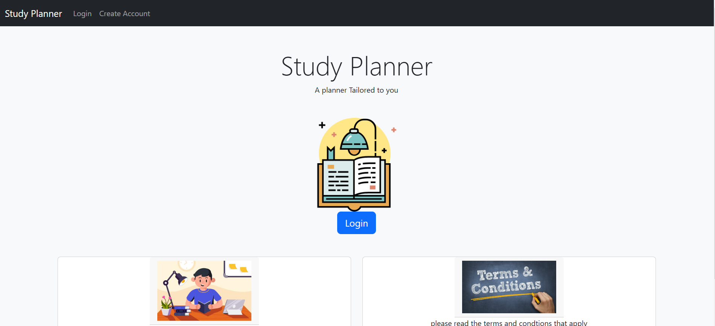
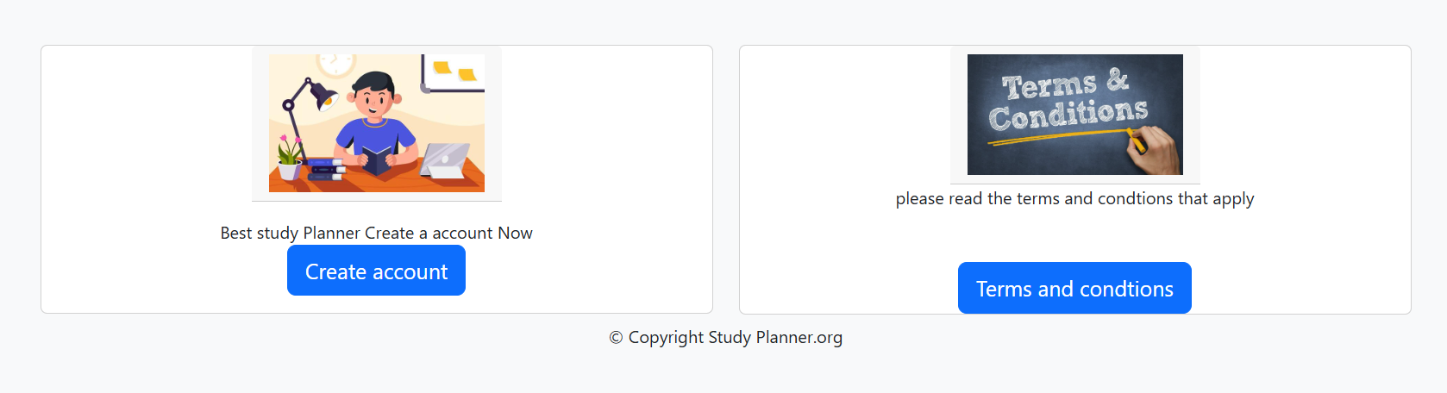
Opening Website Page
This is what you will log into as soon as you enter the site, the start of the study planner, includes a nice plain but professional design. This page shows/ tells the users to log in or create a account, if the user chooses to, they can come and enter the terms and conditions page where they are shown the terms and conditions of the website.
The top has a navigation bar that includes the login or create a account, the bottom has cards that I have created that have buttons to allow the user to create a account or vist the terms and conditions page and finally right at the bottom I have a footer that introduces the copyright claims stating that the this is our website so no one can copy anything we have in it.

Slide 3
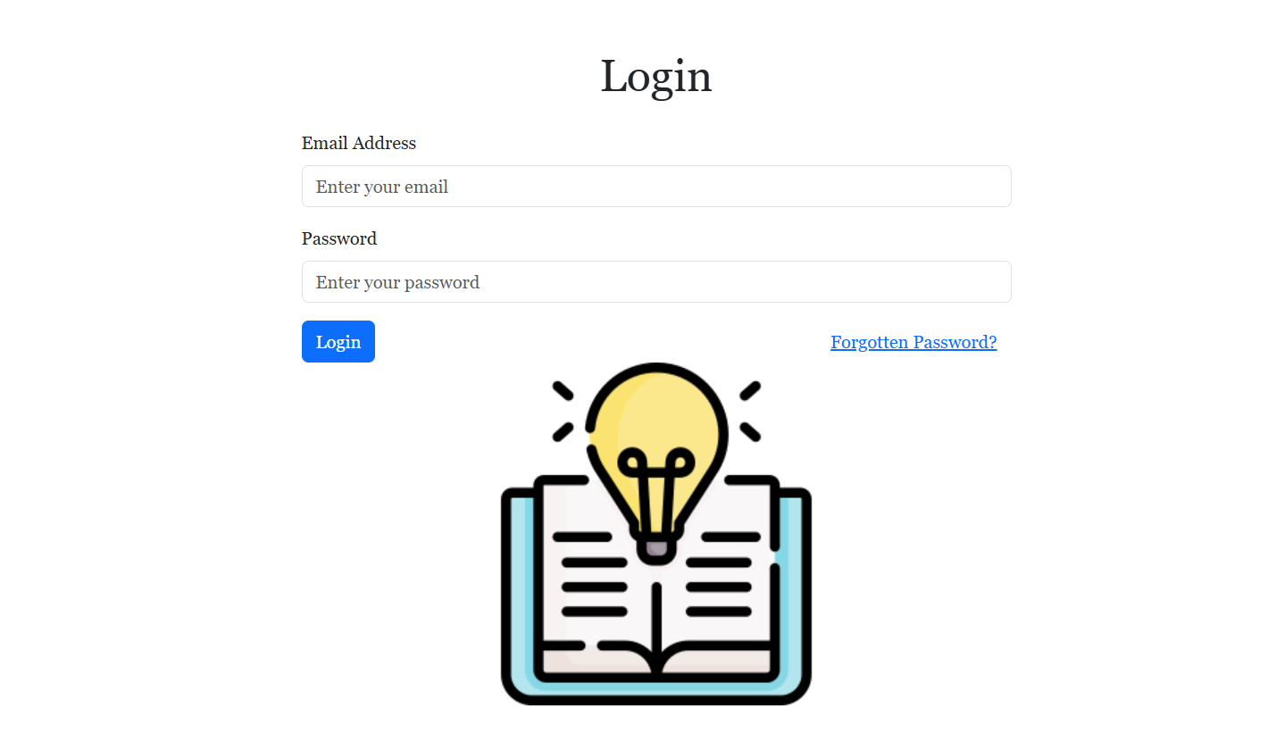
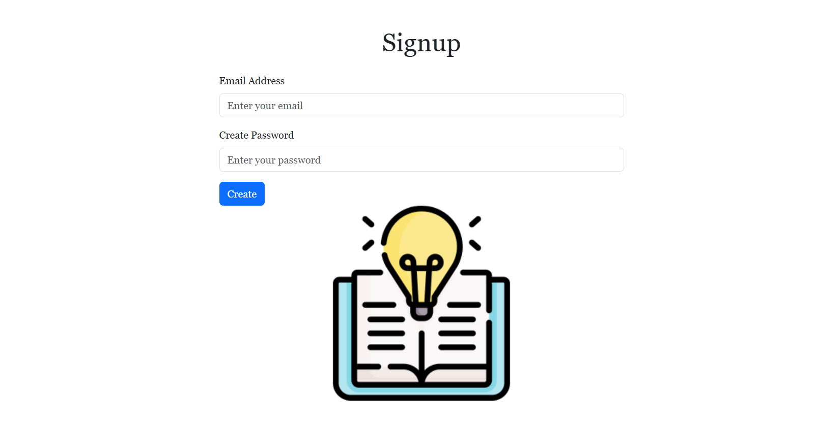
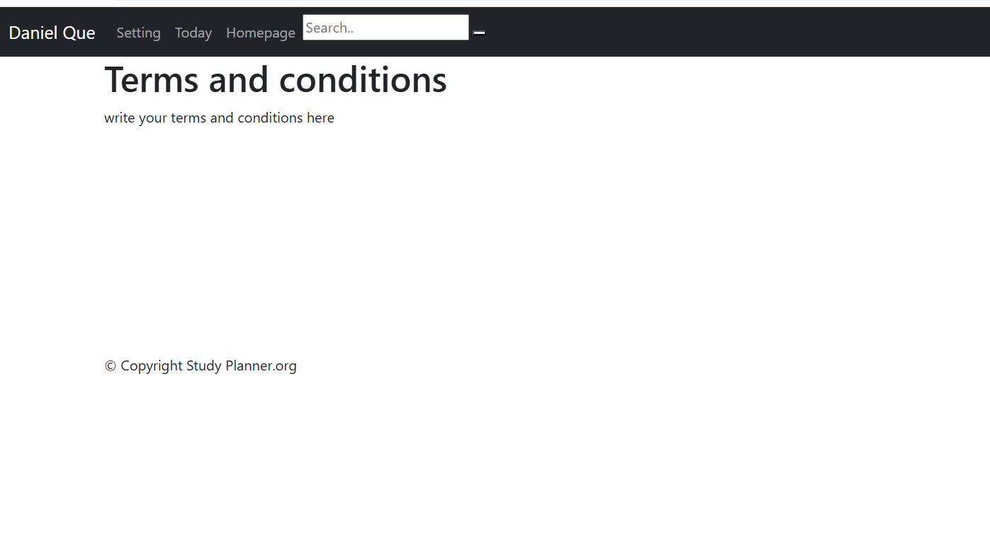
Log in Page
Here are the log in, sign up and terms and condtion page,
The log in page allows the user to log in, you can input a email= daniel@gmail.com and a password=123
And when you press log in it will take you staright to the homepage of the app. If you press forgot password it will take you to the sign up page.
The sign up page allows a user to create a account, once they press create they are then able to log into the homepage of the website, you can input any email and any password that you might desire.
The terms and condition page makes it so that the user is able to read the terms and conditons how ever because this is a design there are no terms and conditions however the company will be able to add the terms and condition.

Slide 4
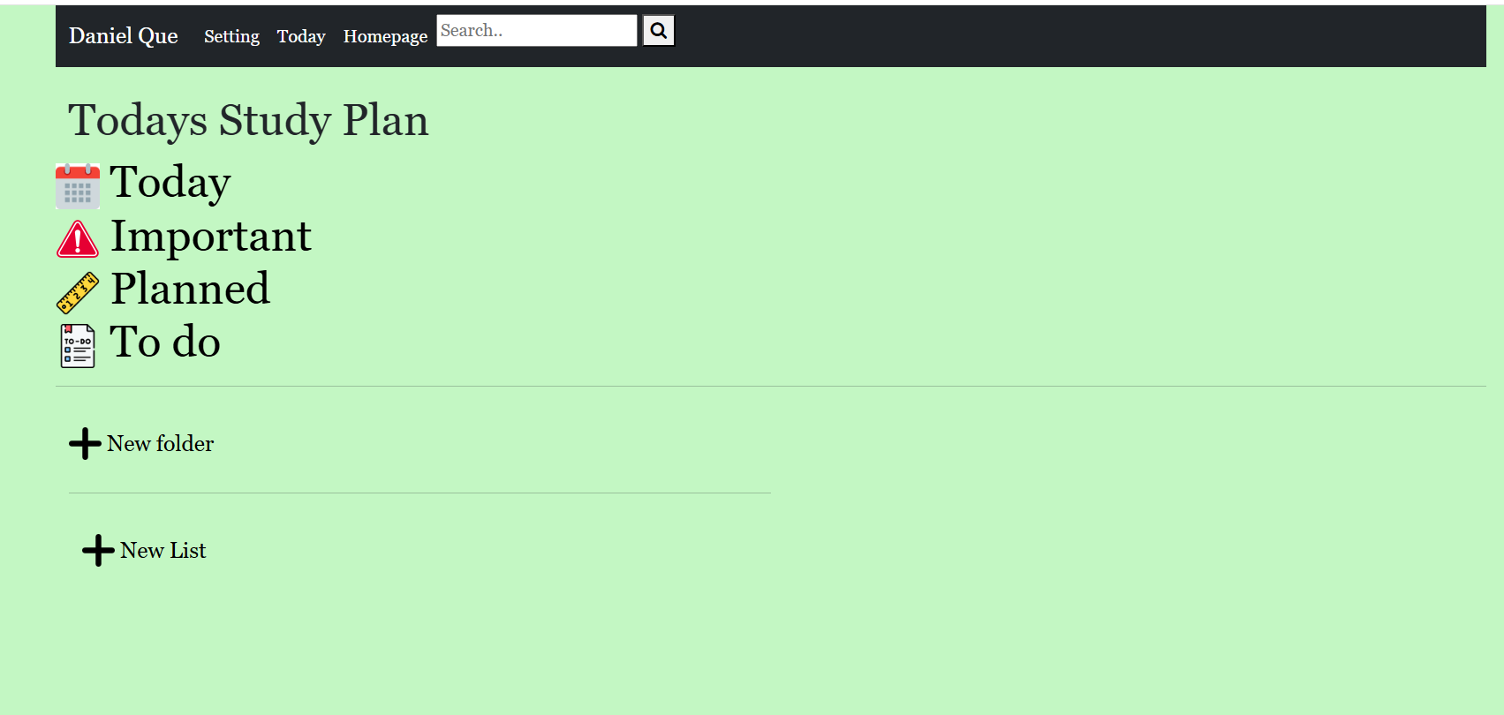
Homepage
This is a new navigation bar that includes settings today and homepage that you can press on and it will take you the site. If you press on my name, you will get sent back into the opening page and must log in again
You can press on this page to go onto the part of the website where you can add in what you got planned all of these buttons will take you to this part of the website as everything that is listed is listed on that part of the website.

Slide 5
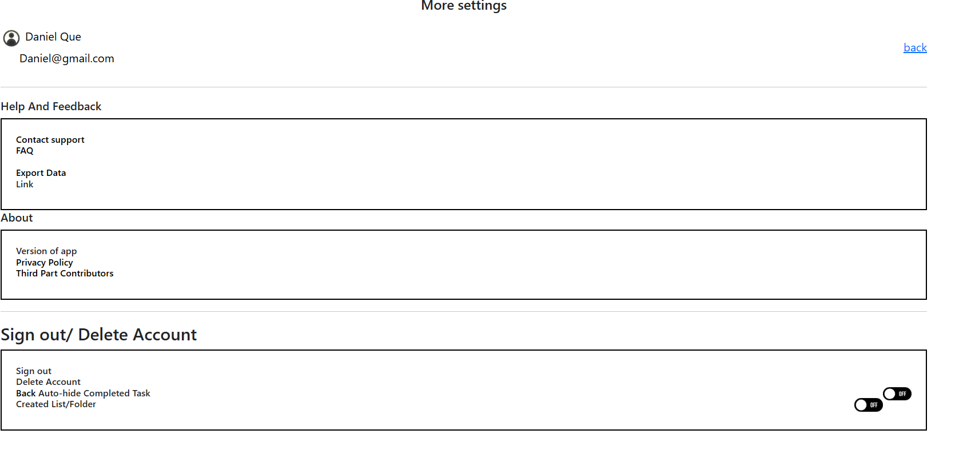
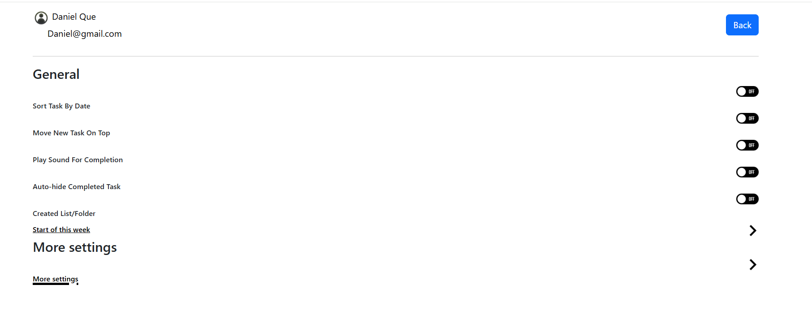
Settings
This is the setting back you can press on start of the week to take you to a new page, however the on and off buttons are not interactive, yet this was just the design that I would recommend to be implemented.
The more setting buttons, will take you to the more settings this is because the website didn't have enough room so I created a new page for more setting features.
More settings, these settings are more interactive, you can press on the contact support and the Faq both taking you take a page where you can contact support or look at frequently asked question .
You can press on export data to see the exportation that you can do.
You can press on the thirdparty and privacy polices where you can see those sites too

Slide 6
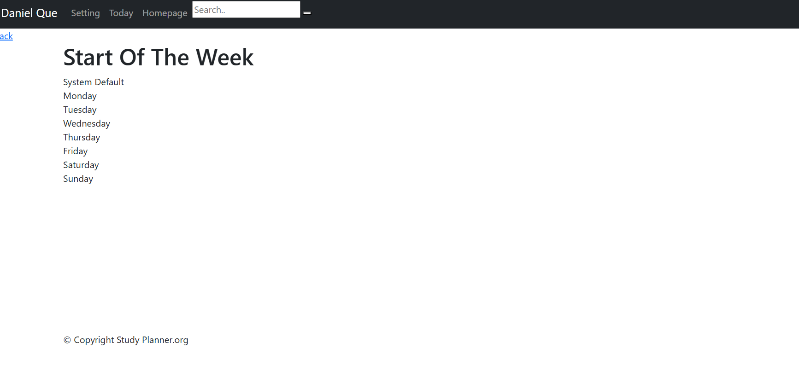
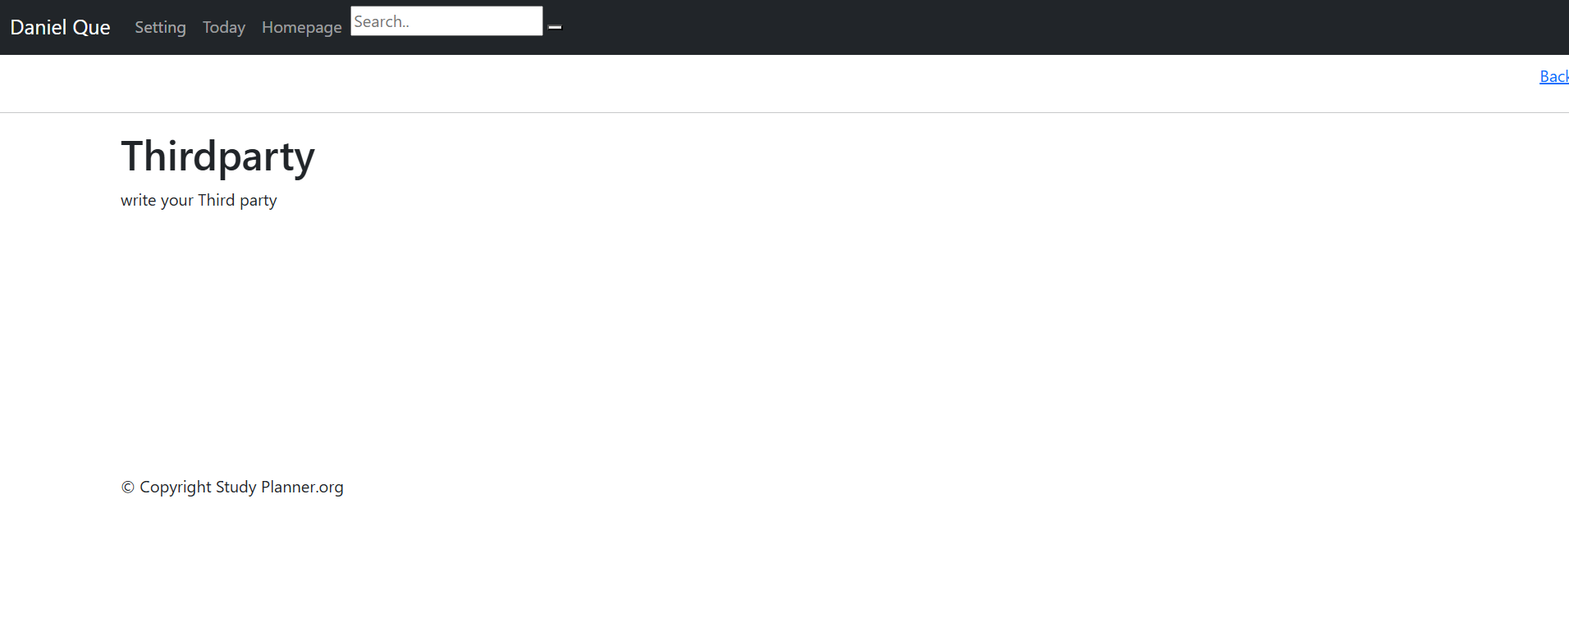
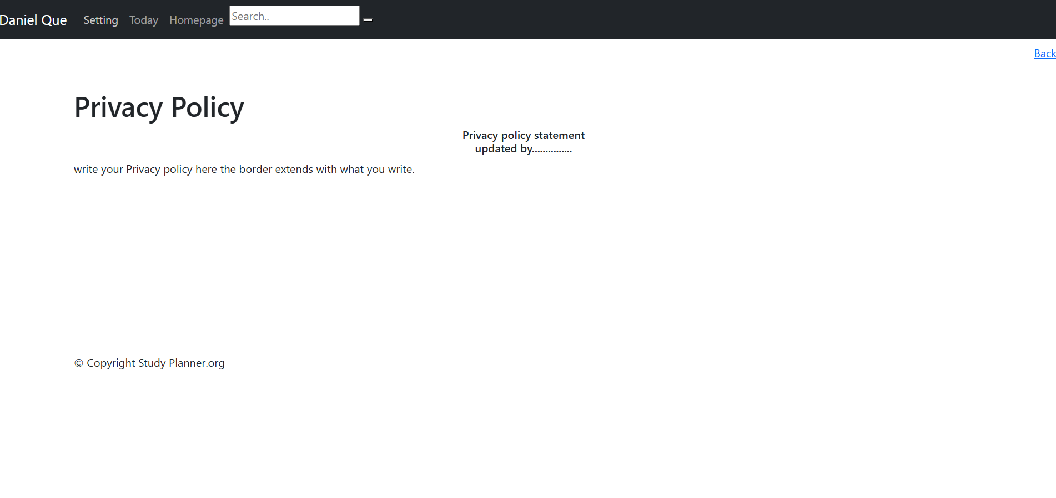
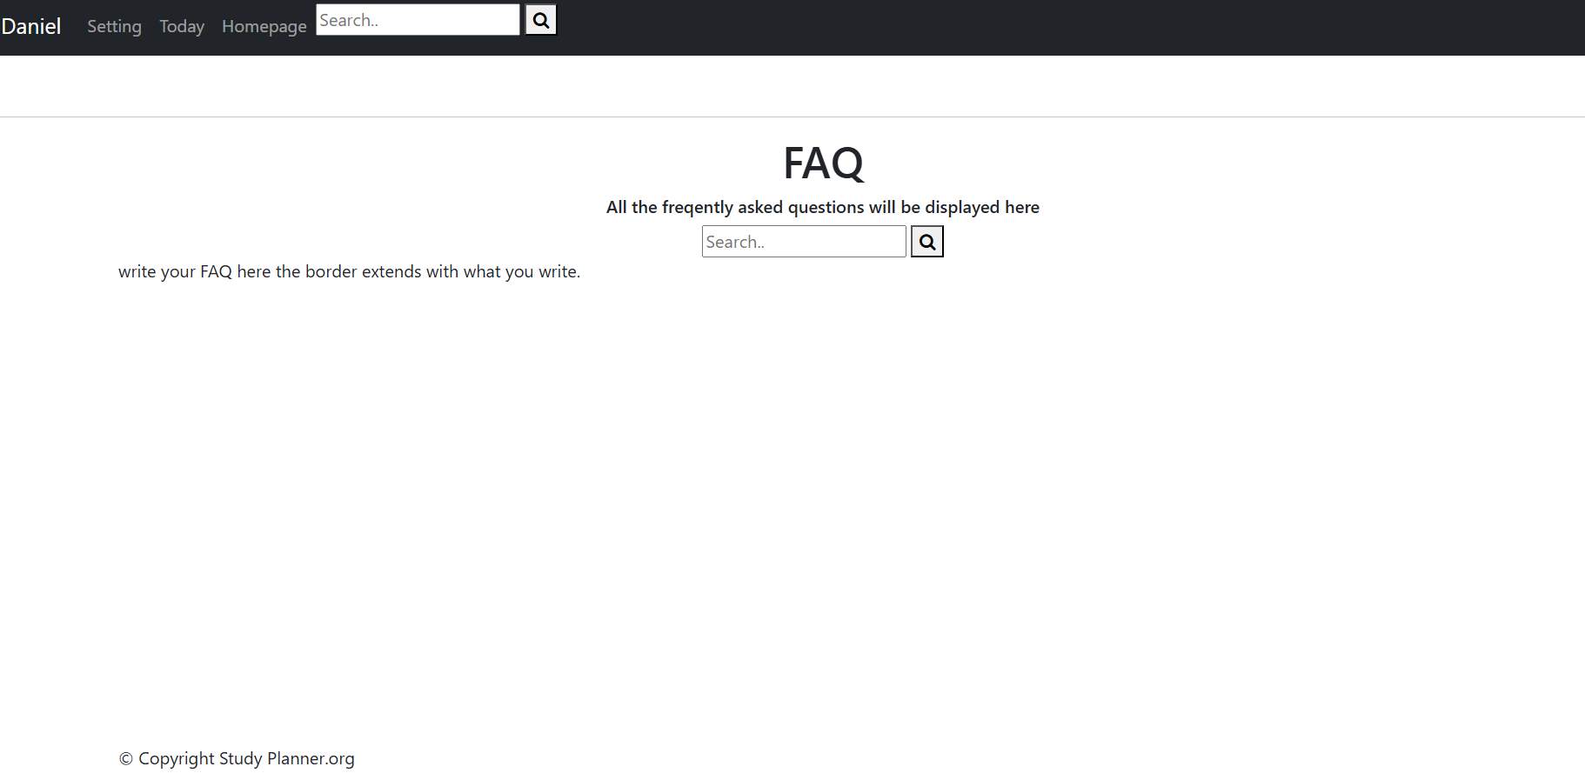
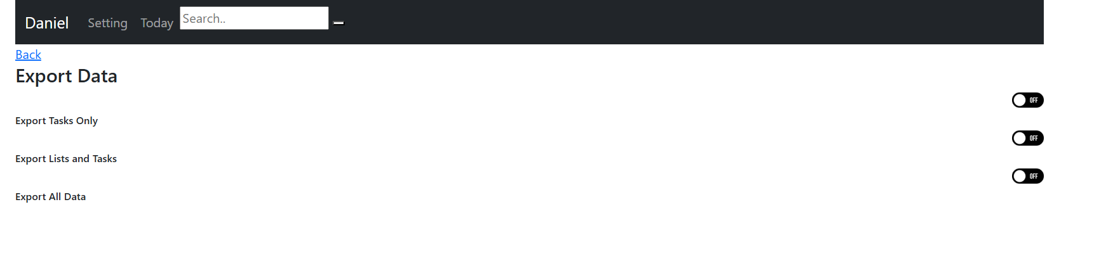
Sites you can enter
These are the sites you can enter as previously mentioned, I created these sites using jinja as they are mostly similar in the template that I wanted to create. However you can type out the faq and write everything you want to create as well

Slide 7
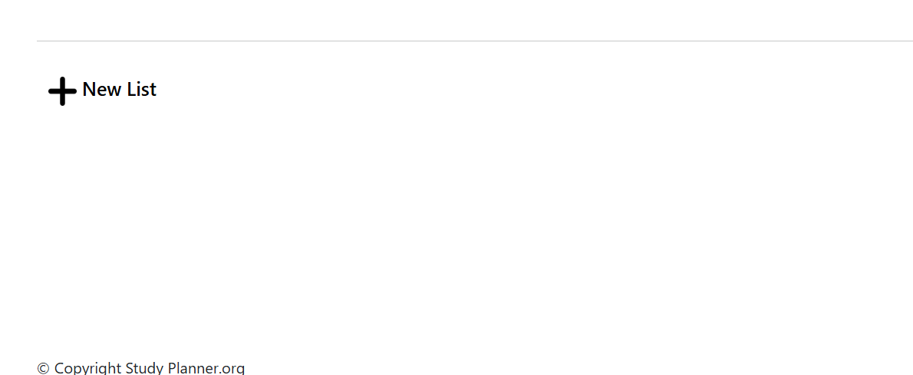
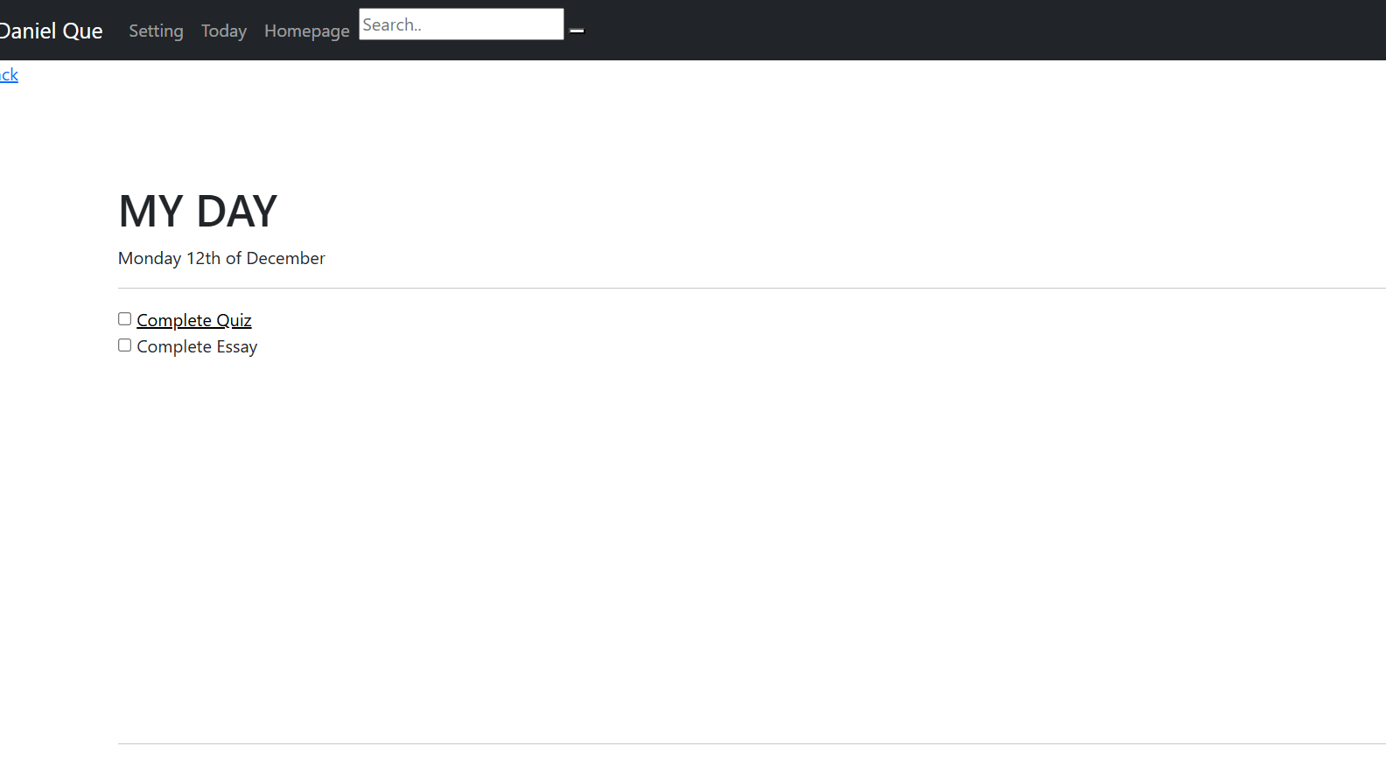
Today Page
This is the part of the website that the user can edit there tasks for the day, you can tick and untick the boxes and you can press on every tab to see what you can add to it.
There is also a navigation bar and footer as shown in previous as I used jinja to design most of my website.

Slide 8

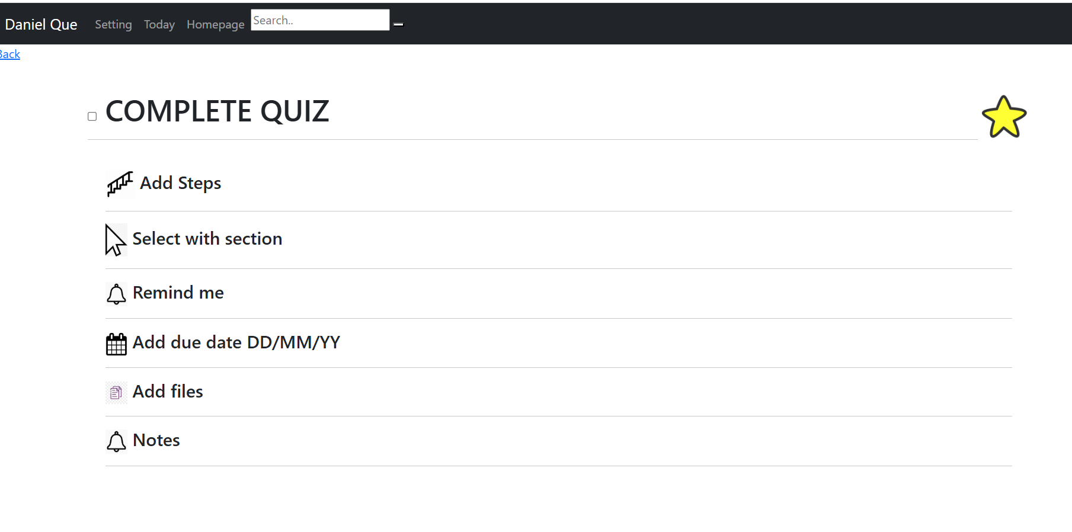
Inside of Today page
This is the final page of the website that I had to create, I tried to follow the examples where you will receive pop ups however when I tried to implement it using modals, it didn’t work so unfortuntely I was unable to add it in, however there it isn't really interactive here

